Slide 1
Using Building Permits to Identify Gentrification in DC
Stephanie Blenko

Slide 2
Hypotheses
I expect to find clear correlations between the number of building permit applications in an area and whether that area has been gentrified.
I also expect to find that certain types of permit applications are more common in gentrified areas.

Slide 3
Gentrification in Washington, D.C.
Defining Gentrification
Difficult to be specific
Phenomenon associated with a sudden increase in property value and a change in native population; usually high correlations with rise in average income, education level and and decrease in minorities living in the area
20th Century Gentrification:
1940’s - Georgetown, Foggy Bottom, Capitol Hill
1960’s – Logan Circle, Adams Morgan, Shaw, Dupont Circle
21st Century Gentrification:
Columbia Heights, U Street, Petworth

Slide 4
Research
Governing Data
Identifies census tracts gentrified between 2000 and 2010 Census
Gentrification definition based on growth in median home values and educational attainment
Eligibility: median income and median home value below 40th percentile in 2000
Investopedia Analysis
Summary of the data provided by Governing
Grouped gentrified census tracts into seven neighborhoods (Columbia Heights, Eckington, Navy Yard, H Street Corridor, Petworth, Southwest, Truxton Circle)

Slide 5
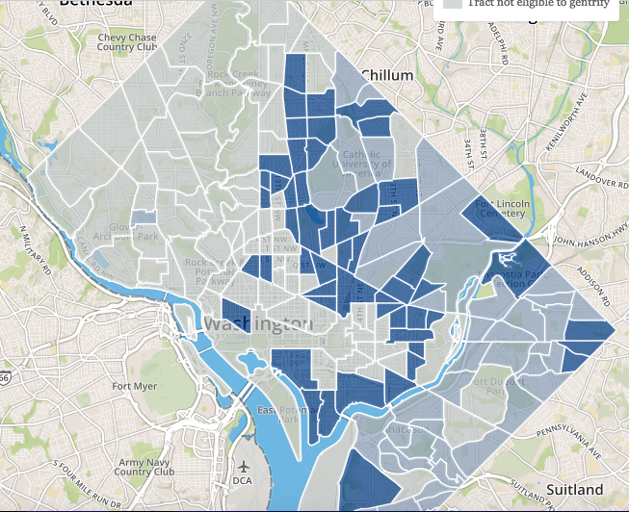

Slide 6

Data
Building Permits from 2012-2017
Where the work was taking place, the type of work being done, the cost of the permit, status of the project
Merge observations into one dataset
Left-join with Neighborhood Cluster data

Slide 7
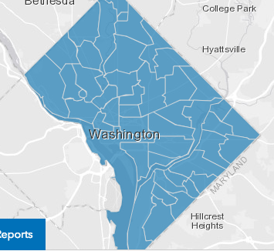
Data
Neighborhood Clusters
DC Planning and Zoning Departments have created definitions and boundaries for 39 neighborhoods in order to qualify locations at a level between Ward and census tract

Slide 8
DC Wards

Slide 9
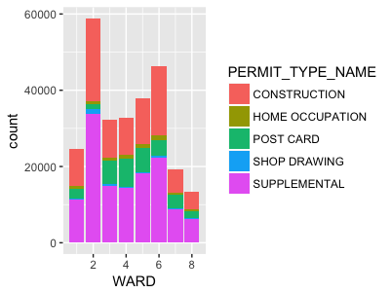
Data Visualization

Slide 10
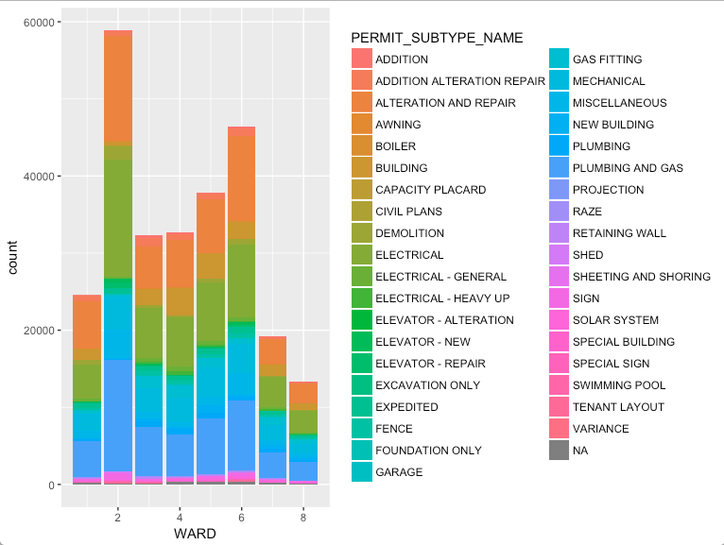
Data Visualization

Slide 11
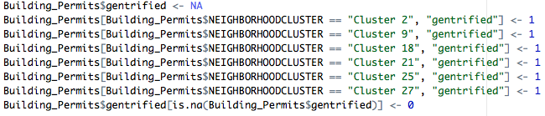
Gentrification Variable
Binary variable
Paired Investopedia analysis with corresponding neighborhood clusters
Considered to be “correct”

Slide 12
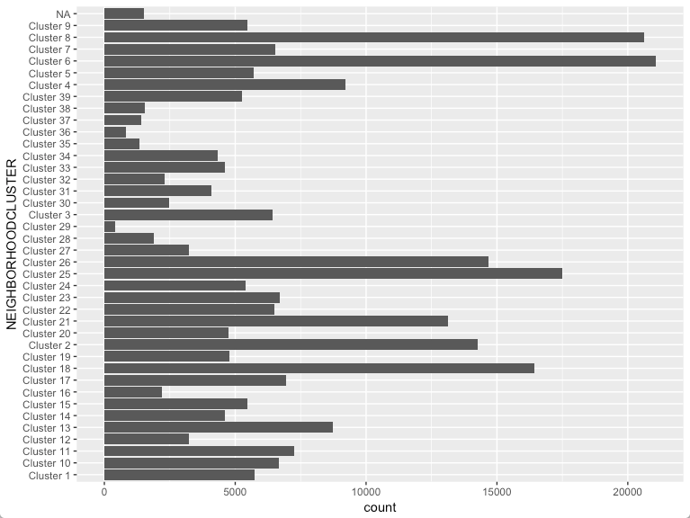
Many_Permits Variable

Slide 13

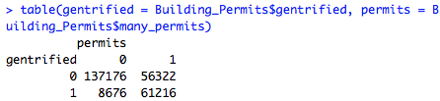

Answering Hypothesis

Slide 14


Further Research
Application Fees
For residential projects: based on square footage
For commercial projects: based on project cost
Fees vary greatly!!!
What if we narrowed the field?

Slide 15
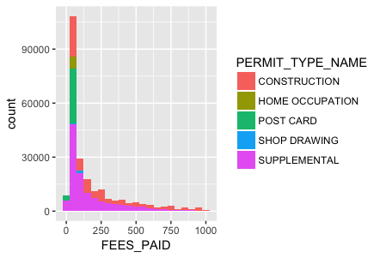
Further Research

Slide 16
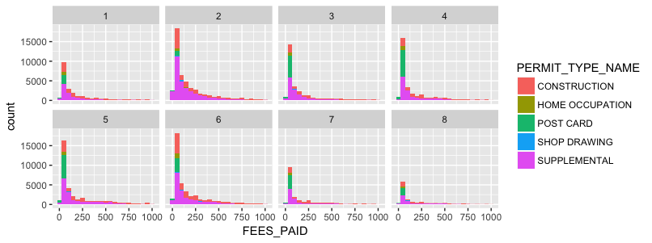

Slide 17

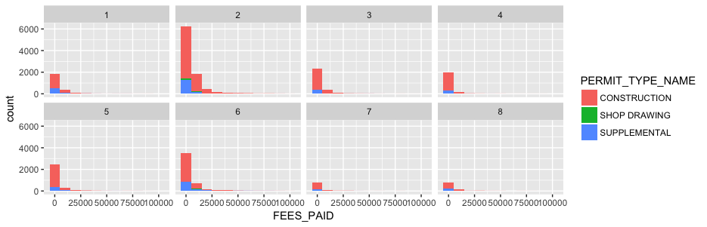

Slide 18
Possible Confounders
Ward 2 consistently has the most permits, no matter how they’re broken down; this ward includes the CBD and the Mall
Sloppy definition of gentrification; possible incorrect qualification of Wards 7 and 8 as “gentrifying”
Incredibly high application fees: are they even correct?

Slide 19
Questions?

